Slide 1


KIET Group of Institutions, Ghaziabad
(An ISO – 9001: 2008 Certified & ‘A+’ Grade accredited Institution by NAAC)
Project Presentation
Virtual visit to Indian Pilgrimages
PCS14
“DARSHAN”
Guide Name: Ms.Arti Sharma
Ankita Rahi CS7B 2200290129004
Atul Sharma CS7B 2200290129007
Digambar Tiwari CS7B 2200290129010
Utkarsh Srivastava CS7B 2200290129018

Slide 2
Problem Statement
Geographical obstacles can be overcome and tourism can be increased by developing a
virtual platform for Indian pilgrimage sites. It will provide spiritual experiences and protect
religious history. Issues with accessibility for all users, cultural authenticity, and connectivity must all be addressed by the platform.

Slide 3
Objectives
Provide virtual tours of the main places visited by pilgrims.
Respect and uphold cultural and religious traditions.
Remove obstacles for pilgrims, both physical and geographical.
Boost spiritual involvement and tourism with digital tools.

Slide 4
Technology Used
FrontEnd
BackEnd
External Tool
HTML | MongoDB | AR/VR Headset
CSS | NodeJS
Java Script | Unity

Slide 5
Literature Survey
Title: "Virtual Reality for Religious Tourism: A Case Study of Kashi Vishwanath Temple, Varanasi" Authors: Deepak Sood and Sumit Srivastava
Year: 2020
Title: "Virtual Reality in Pilgrimage Tourism: A Study on Haridwar" Authors: Manoj Sharma and Pooja Rani
Year: 2018
Title: "Exploring the Potential of Virtual Reality in Indian Pilgrimage Tourism: A Case Study of Rameswaram" Writers: V. Ananthanarayanan and S. Rajagopalan
Year:2021
Title: "Immersive Virtual Experiences in Indian Pilgrimage Sites: A Study on the Impact of 360-Degree Virtual Tours" Writers: Amit Singh, Neha Gupta
Year:2019

Slide 6
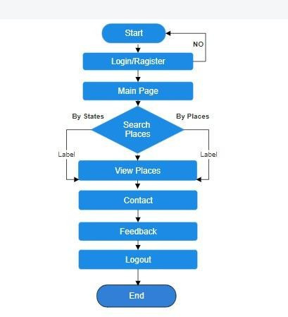
Workflow Diagram

Slide 7
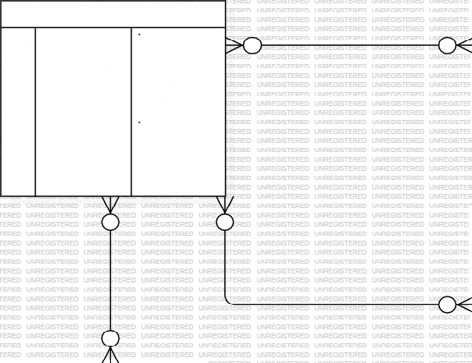
ER Diagram Of
Darshan
User Table
Pilgrimage Destination | Pilgrimage Destination | Pilgrimage Destination
PK | destination id Name Description Location | int varchar varchar varchar
rK User id User Name Email password Address Phone no. DOB
int varchar varchar varchar varchar int
date
Review Table | Review Table | Review Table
I.Iserid | I.Iserid | int
Destination id | Destination id | int
Rating | Rating | varchar
Comment | Comment | varchar
Date | Date | date
Tour Package | Tour Package | Tour Package
PK | Package id | int
 | Name | varchar
 | Dearriptinn | varr.far
 | Pricc | int
 | Duration | date
 | Start date | date
 | enrl rlate | rlate
Booking Table | Booking Table | Booking Table
PK | Booking id User id Package irl Total amount | int int int int
Payment table
PK Payment id int Aizzouizt int F'ayment date date Ranking irl int

Slide 8
Alignment with UN Sustainable Development Goals
SDG 4: Quality Education
Provides access to knowledge and understanding of different cultures and religions.
SDG 10: Reduced Inequalitie
Breaks down barriers to pilgrimage by making it accessible to all.
SDG 13: Climate Action
Reduces the environmental impact of physical pilgrimages by promoting virtual alternatives.

Slide 9
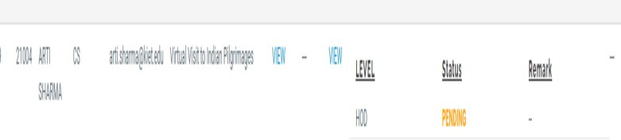
Patent Status

Slide 10
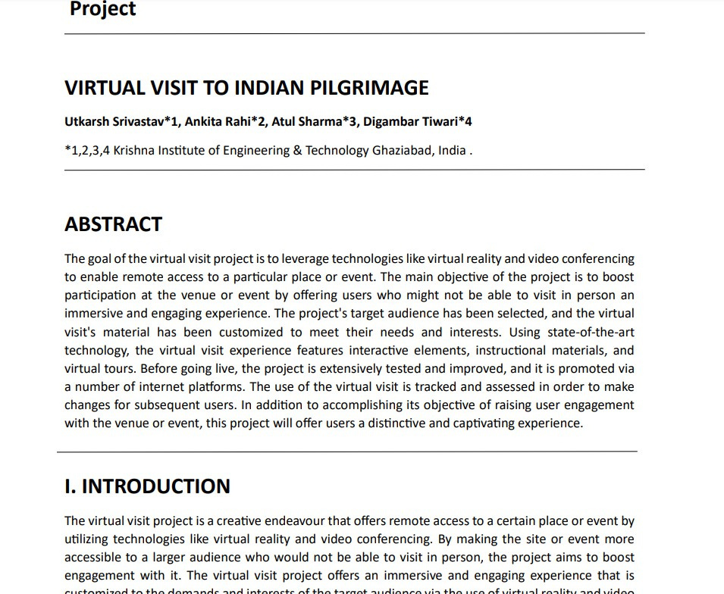
Research Paper Status

Slide 11
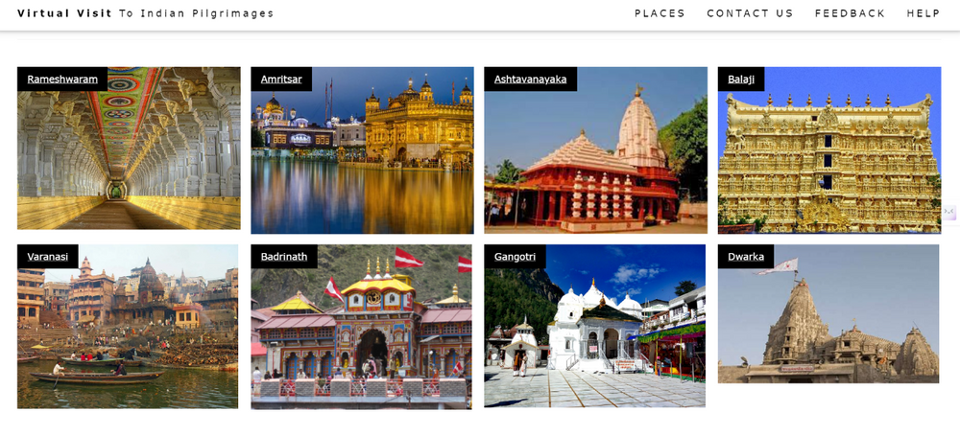
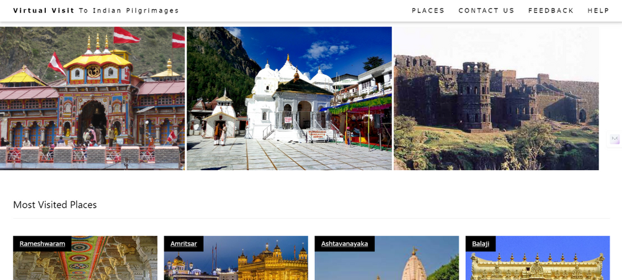
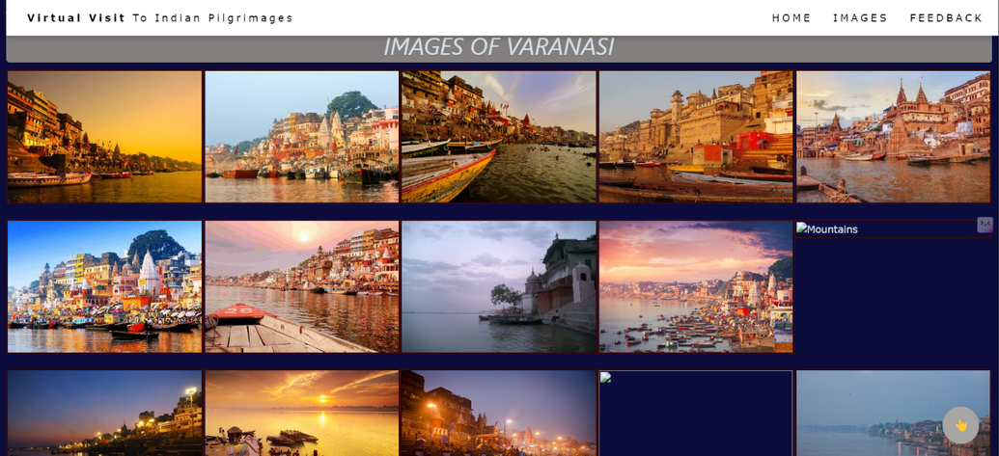
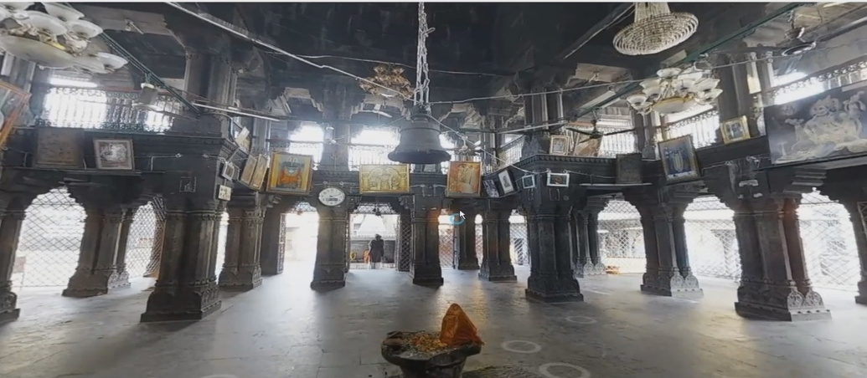
Project Status

Slide 12
Thank You

